Slide 1
Programming Language
第15組
組員:陳麥克60% 林柏安40%
Notes:
請用投影片放映(第4頁)

Slide 2
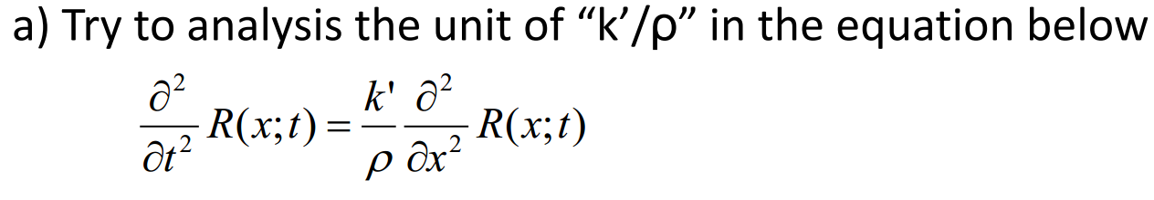
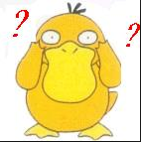


Question(a)
波動方程式
偏微分

Slide 3
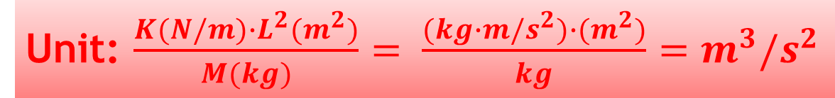
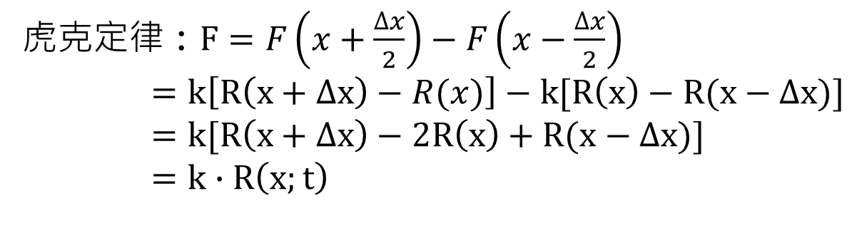
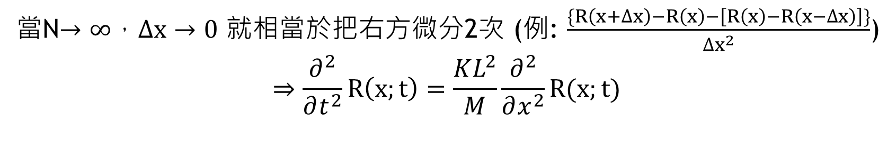
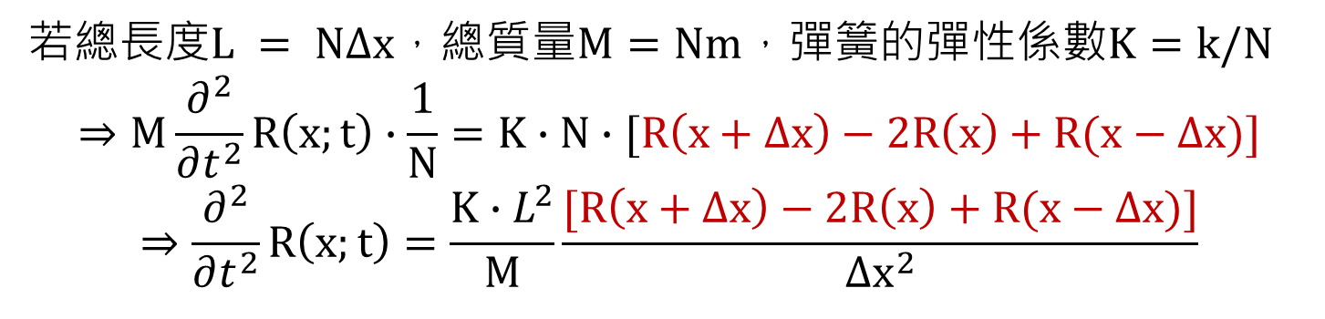
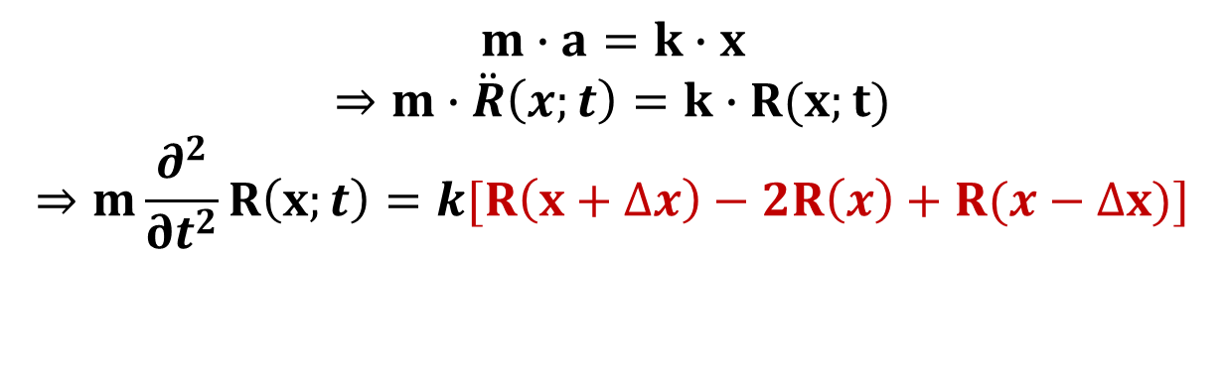
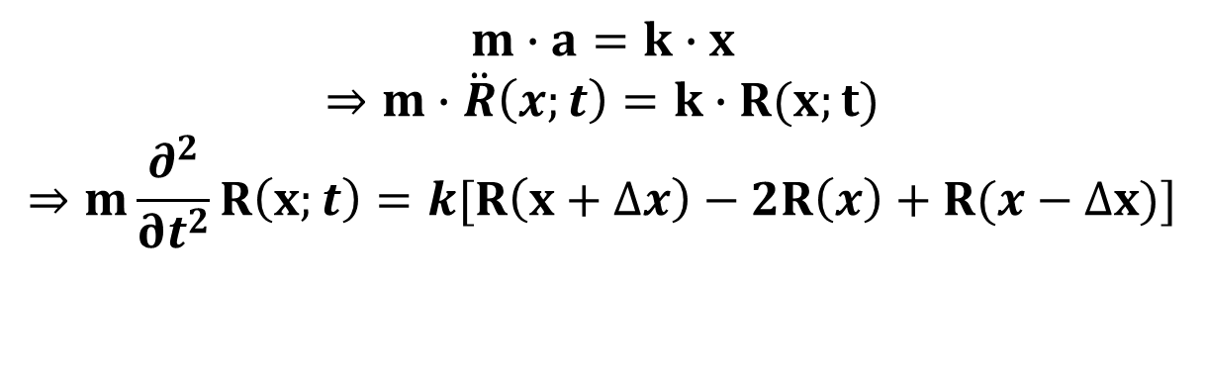
Solution(a)
$$m∙a=k∙x$$
$$⇒m∙\ddot{R}\left(x;t\right)=k∙R(x;t)$$
$$⇒m\frac{∂^{2}}{∂t^{2}}R\left(x;t\right)=k[R\left(x+∆x\right)−2R\left(x\right)+R(x−∆x)]$$
牛頓第二定律 : $F=m∙a\left(t\right)=m∙\frac{∂^{2}}{∂t^{2}}R\left(t\right)=m\ddot{R}\left(x;t\right)$
虎克定律 : $F=F\left(x+\frac{∆x}{2}\right)−F\left(x−\frac{∆x}{2}\right)$
$=k\left[R\left(x+∆x\right)−R(x)\right]−k[R\left(x\right)−R(x−∆x)]$
$=k[R\left(x+∆x\right)−2R\left(x\right)+R(x−∆x)]$
$=k∙R\left(x;t\right)$
若總長度$L = N∆x$，總質量$M=Nm$，彈簧的彈性係數$K=k/N$
$$⇒M\frac{∂^{2}}{∂t^{2}}R\left(x;t\right)∙\frac{1}{N}=K∙N∙[R\left(x+∆x\right)−2R\left(x\right)+R(x−∆x)]$$
$$⇒\frac{∂^{2}}{∂t^{2}}R\left(x;t\right)=\frac{K∙L^{2}}{M}\frac{[R\left(x+∆x\right)−2R\left(x\right)+R(x−∆x)]}{{∆x}^{2}}$$
$$m∙a=k∙x$$
$$⇒m∙\ddot{R}\left(x;t\right)=k∙R(x;t)$$
$$⇒m\frac{∂^{2}}{∂t^{2}}R\left(x;t\right)=k[R\left(x+∆x\right)−2R\left(x\right)+R(x−∆x)]$$
當N$→∞$，$∆x→0$ 就相當於把右方微分2次 (例: $\frac{\{R\left(x+∆x\right)−R\left(x\right)−\left[R\left(x\right)−R\left(x−∆x\right)\right]\}}{{∆x}^{2}}$)
$$⇒\frac{∂^{2}}{∂t^{2}}R\left(x;t\right)=\frac{KL^{2}}{M}\frac{∂^{2}}{∂x^{2}}R(x;t)$$
Unit: $\frac{K(N/m)∙L^{2}(m^{2})}{M(kg)}= \frac{(kg∙m/s^{2})∙(m^{2})}{kg}=m^{3}/s^{2}$

Slide 4
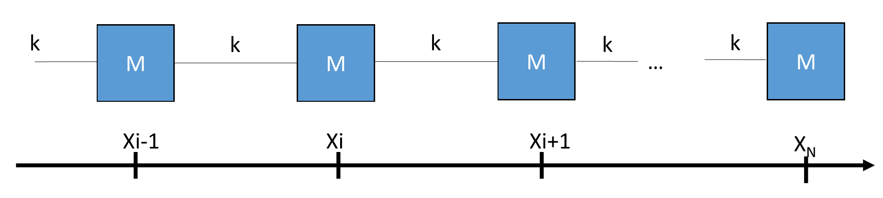
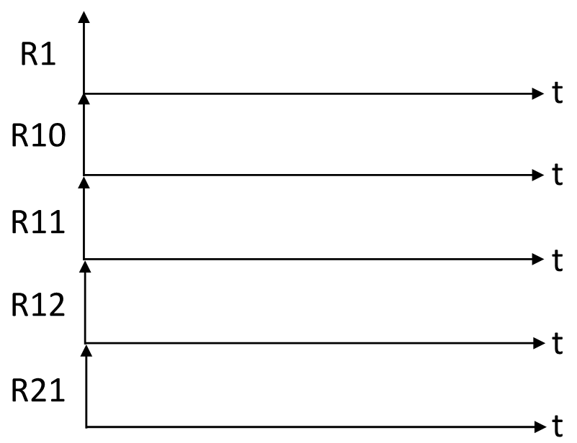
Question(b)
b) Try to plot a figure shown below
Mi=2.5 M11=5.0
N = 21
K = 1
R1= 2
沒有牆壁,故兩側沒有彈簧
R2=V1=V2= 0 at t = 0
two ends are free

Slide 5
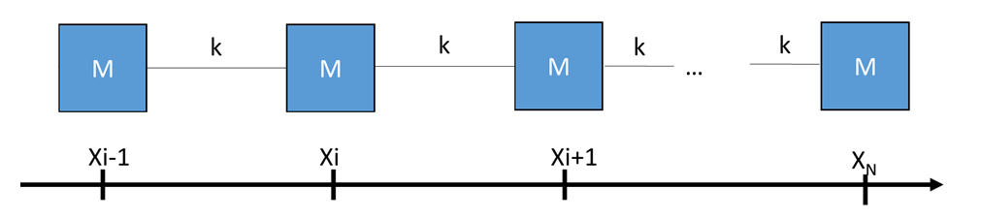
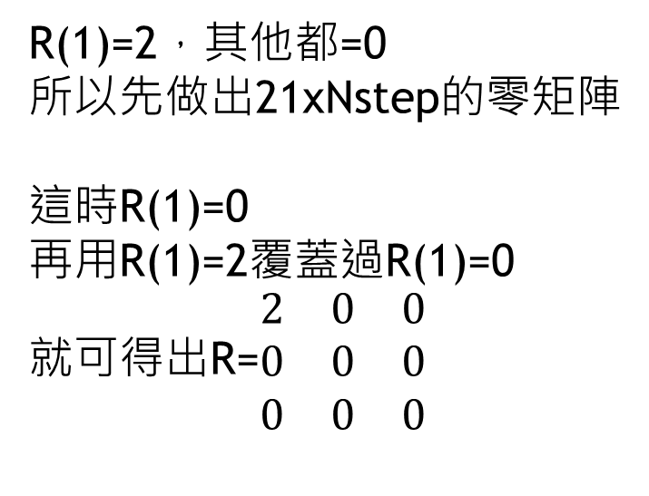
Solution(b)
先定好初始條件:
Dur = 80;
dt = 0.002;
Nstep = ceil(Dur/dt);
k=1 ;
M=2.5 ; M11=5;
R=zeros(21,Nstep);
V=zeros(21,Nstep);
R(1)=2
t=0;
R(1)=2，其他都=0
所以先做出21xNstep的零矩陣
這時R(1)=0
再用R(1)=2覆蓋過R(1)=0
就可得出R=$\begin{matrix}2 & 0 & 0 \\ 0 & 0 & 0 \\ 0 & 0 & 0\end{matrix}$
……
……
……

Slide 6
Solution(b)
~再來逐項慢慢解說我們的主程式迴圈~
for j = 1:Nstep-1
V(1,j+1) = ((-k*(R(1,j)-R(2,j)))/M)*dt+V(1,j);
for i = 2:20
if i == 11
V(i,j+1) = ((k*(R(i+1,j)-2*R(i,j)+R(i-1,j)))/M11)*dt+V(i,j);
else
V(i,j+1) = ((k*(R(i+1,j)-2*R(i,j)+R(i-1,j)))/M)*dt+V(i,j);
end
end
V(21,j+1) = ((-k*(R(21,j)-R(20,j)))/M)*dt+V(20,j);
for i = 1:21
R(i,j+1) = V(i,j)*dt+R(i,j);
end
t(j+1) = j*dt;
end

Slide 7
Solution(b)
那為什麼第1塊跟最後1塊的V
要跟2~20分開算呢?
~再來逐項慢慢解說我們的主程式迴圈~
for j = 1:Nstep-1
V(1,j+1) = ((-k*(R(1,j)-R(2,j)))/M)*dt+V(1,j);
for i = 2:20
if i == 11
V(i,j+1) = ((k*(R(i+1,j)-2*R(i,j)+R(i-1,j)))/M11)*dt+V(i,j);
else
V(i,j+1) = ((k*(R(i+1,j)-2*R(i,j)+R(i-1,j)))/M)*dt+V(i,j);
end
end
V(21,j+1) = ((-k*(R(21,j)-R(20,j)))/M)*dt+V(20,j);
for i = 1:21
R(i,j+1) = V(i,j)*dt+R(i,j);
end
t(j+1) = j*dt;
end
在2~20迴圈中
使用if是因為
M11的質量跟其他的不同
故當計算到第11塊時
須以M11 = 5 來除
其他的則以M=2.5來除
跟之前一樣，
我們在for 1:Nstep迴圈中
計算每個block的速度
V = Vi + at (a= kx/m)
計算每個block的位移
R = Ri + Vt

Slide 8
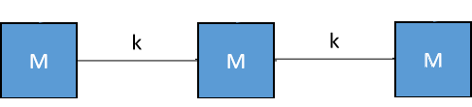
Solution(b)
for j = 1:Nstep-1
V(1,j+1) = ((-k*(R(1,j)-R(2,j)))/M)*dt+V(1,j);
for i = 2:20
if i == 11
V(i,j+1) = ((k*(R(i+1,j)-2*R(i,j)+R(i-1,j)))/M11)*dt+V(i,j);
else
V(i,j+1) = ((k*(R(i+1,j)-2*R(i,j)+R(i-1,j)))/M)*dt+V(i,j);
end
end
V(21,j+1) = ((-k*(R(21,j)-R(20,j)))/M)*dt+V(20,j);
for i = 1:21
R(i,j+1) = V(i,j)*dt+R(i,j);
end
t(j+1) = j*dt;
end
因為迴圈是做重複的動作
但是block1跟block21沒有連牆
a的求法跟其他block不同
所以要放在迴圈外
另外列出來計算
第1塊(N1)及最後一塊(N21) 左右部分沒有連牆
N1
N21

Slide 9
Solution(b)
for j = 1:Nstep-1
V(1,j+1) = ((-k*(R(1,j)-R(2,j)))/M)*dt+V(1,j);
for i = 2:20
if i == 11
V(i,j+1) = ((k*(R(i+1,j)-2*R(i,j)+R(i-1,j)))/M11)*dt+V(i,j);
else
V(i,j+1) = ((k*(R(i+1,j)-2*R(i,j)+R(i-1,j)))/M)*dt+V(i,j);
end
end
V(21,j+1) = ((-k*(R(21,j)-R(20,j)))/M)*dt+V(20,j);
for i = 1:21
R(i,j+1) = V(i,j)*dt+R(i,j);
end
t(j+1) = j*dt;
end
我們將每個木塊求出移動距離(R)
(R = Ri + Vt)

Slide 10
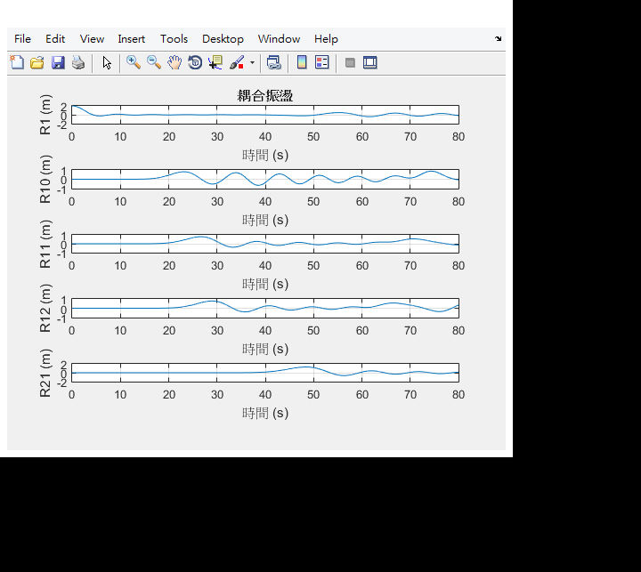
Solution(b)
subplot(5,1,1),plot(t,R(1,:))
Title(‘耦合震盪')
xlabel(‘時間(s)')
ylabel('R1 (m)')
grid on
subplot(5,1,2),plot(t,R(10,:))
xlabel('時間(s)')
ylabel('R10 (m)')
grid on
subplot(5,1,3),plot(t,R(11,:))
xlabel('時間(s)')
ylabel('R11 (m)')
grid on
subplot(5,1,4),plot(t,R(12,:))
xlabel('時間(s)')
ylabel('R12 (m)')
grid on
subplot(5,1,5),plot(t,R(21,:))
xlabel('時間(s)')
ylabel('R21 (m)')
grid on
最後,以subplot作圖

Slide 11
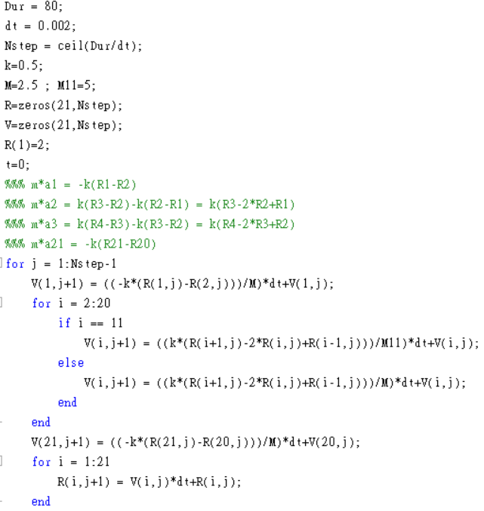
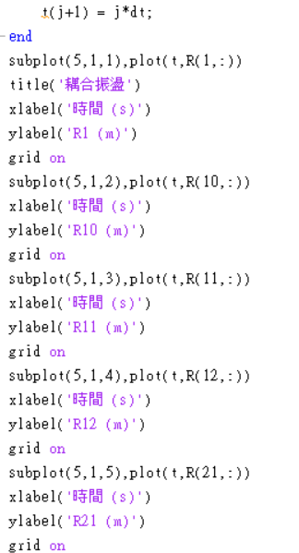
附上Question(b)全程式碼:

Slide 12
Question(c)
Same as Question(b),but change M11 = 5.0 to M11 = 1.0

Slide 13
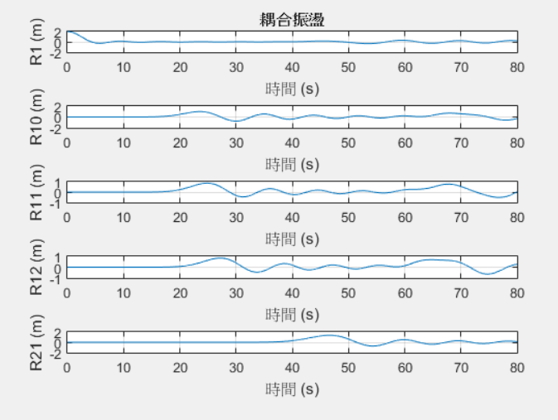
Solution(c)
作圖:
subplot(5,1,1),plot(t,R(1,:))
Title(‘耦合震盪')
xlabel(‘時間(s)')
ylabel('R1 (m)')
grid on
subplot(5,1,2),plot(t,R(10,:))
xlabel('時間(s)')
ylabel('R10 (m)')
grid on
subplot(5,1,3),plot(t,R(11,:))
xlabel('時間(s)')
ylabel('R11 (m)')
grid on
subplot(5,1,4),plot(t,R(12,:))
xlabel('時間(s)')
ylabel('R12 (m)')
grid on
subplot(5,1,5),plot(t,R(21,:))
xlabel('時間(s)')
ylabel('R21 (m)')
grid on
初始條件:
迴圈內容:
Dur = 80;
dt = 0.002;
Nstep = ceil(Dur/dt);
k=1 ;
M=2.5 ; M11=1;
R=zeros(21,Nstep);
V=zeros(21,Nstep);
R(1)=2
t=0;
for j = 1:Nstep-1
V(1,j+1) = ((-k*(R(1,j)-R(2,j)))/M)*dt+V(1,j);
for i = 2:20
if i == 11
V(i,j+1) = ((k*(R(i+1,j)-2*R(i,j)+R(i-1,j)))/M11)*dt+V(i,j);
else
V(i,j+1) = ((k*(R(i+1,j)-2*R(i,j)+R(i-1,j)))/M)*dt+V(i,j);
end
end
V(21,j+1) = ((-k*(R(21,j)-R(20,j)))/M)*dt+V(20,j);
for i = 1:21
R(i,j+1) = V(i,j)*dt+R(i,j);
end
t(j+1) = j*dt;
end

Slide 14
Question(b) vs (c)
(b)
(c)

Slide 15
THE END
謝謝大家!!!!!
←麥克
↑我

